Slide 1


Common SQL Server Mistakes
Steve Jones
SQLServerCental
Red Gate Software

Slide 2
Common SQL Server Mistakes
Using SELECT *
Using a GUID as a Clustered Key
Putting Functions in the WHERE Clause
Using = NULL
Writing Single Row triggers
Indexing all Columns
Using Cursors
SA Account Usage
Shrinking databases
Assigning Permissions to Users

Slide 3

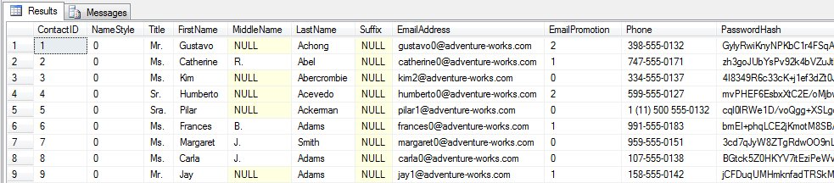
SELECT *
How often does someone do this?

Slide 4
SELECT * - Issues
Performance
  More I/O
  More network bandwidth
  Less cache
Less readable
  You may know what the columns are, but the next person might not.
Does not update in views

Slide 5
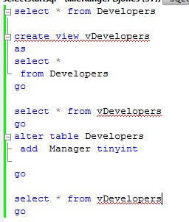
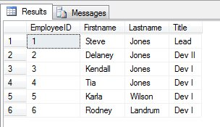
SELECT * - Views

Slide 6
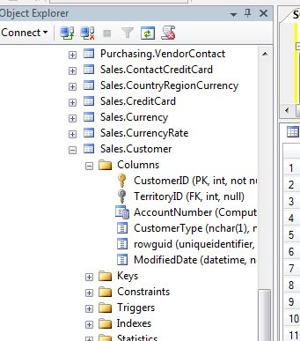
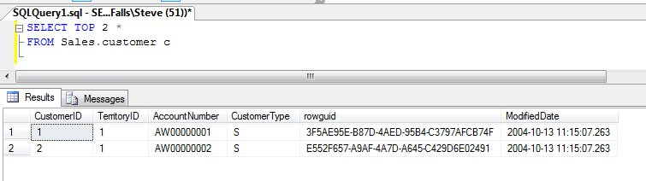
SELECT * - Solutions
Choose the columns you need
If you want to know what columns are in a table…

Slide 7
GUID as Clustered Key
A clustered index keeps the data in order of the index key(s).
GUIDs are not ordered.
The Primary Key is clustered by default

Slide 8
Customer Table – Clustered Index on ID
ID
Name
ID
Name
1
Steve
9
Jack
2
Marc
10
Kevin
3
Paul
11
Jennifer
4
Chris
12
Troy
5
Glenn
6
Carlos
7
Tim
8
Jason

Slide 9
Customer Table – Clustered Index on UID
ID
Name
0C5A7
Chris
0C4D6
Steve
0C5A7
Chris
0C5D8
Marc
0C5A7
Chris
0C5D8
Marc
0C5D8
Marc
0C5B3
0C4D6
Glenn
Steve
0C5D8
Marc
0C4D6
Steve
CA438
Paul
0C5B3
Glenn
CA438
Paul

Slide 11
GUID as Clustered Key – Solutions
Make the GUID a non-clustered index
Use NEWSEQUENTIALID() instead of NEWID()
Use Identity instead

Slide 12


Functions in the WHERE Clause

Slide 13


Functions in the WHERE Clause

Slide 14


Functions in the WHERE Clause

Slide 15

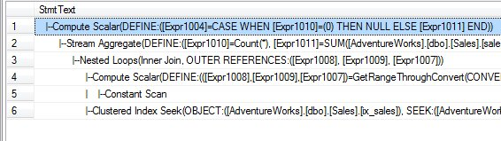
Functions in the WHERE Clause
Exception in 2008

Slide 16
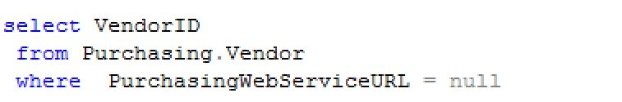
= NULL
NULL is not equal to any other value
  Including itself!

Slide 17
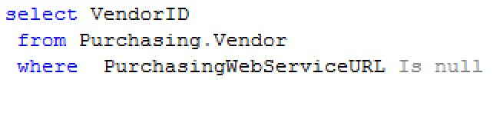
= NULL
Solutions
  Use “Is NULL” or “Is Not NULL”

Slide 18
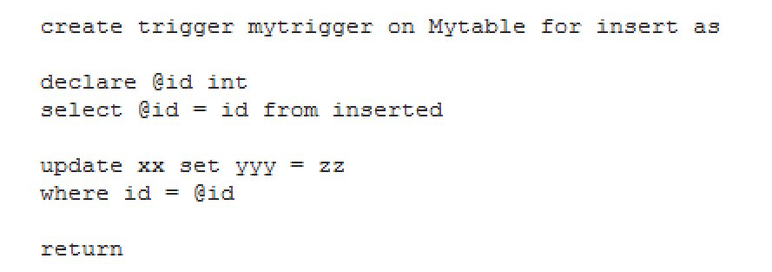
Single Row Triggers
Triggers fire once per DML statement

Slide 19
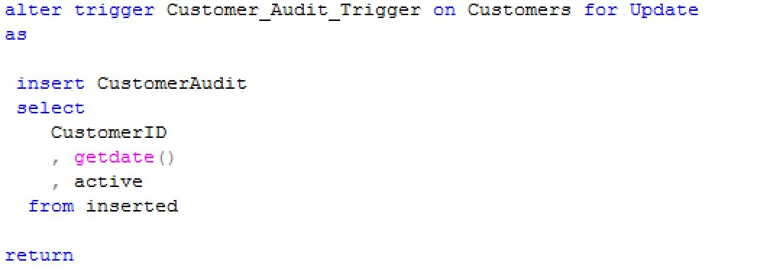
Single Row Triggers

Slide 20
Indexing All Columns
Seen in Third Party Products
Index created on every column
Sometimes reversed indexes
  (lastname, firstname, customerid)
  (Firstname, lastname, customerid)

Slide 21
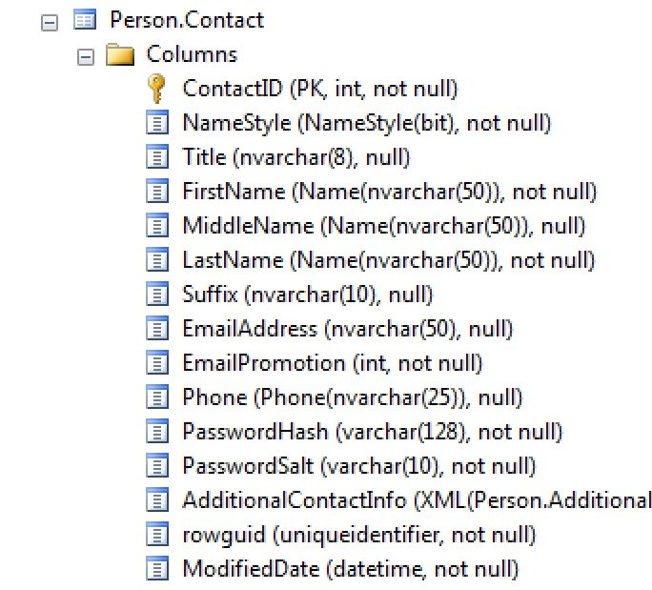
Indexing All Columns

Slide 22
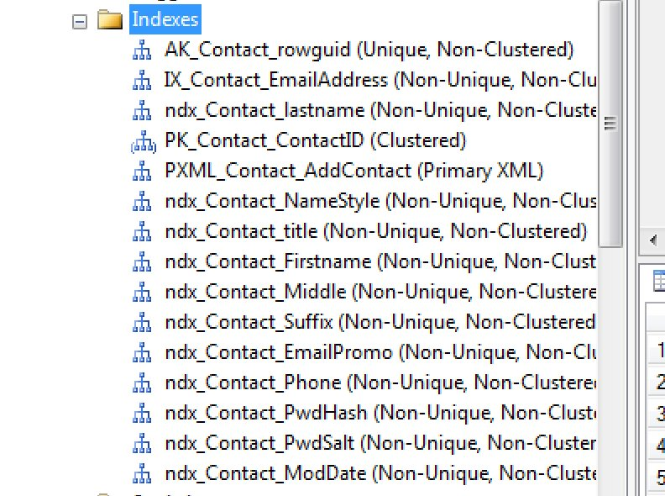
Indexing All Columns

Slide 23
Indexing All Columns
Every DML requires updates on all indexes
Space required for all indexes
Impacts backups and recovery time

Slide 24
Indexing All Columns (Solutions)
Index heavily used columns
Analyze queries for common WHERE clause filters
Limit to 3-6 for OLTP systems
Can implement more indexes for OLAP/DW/Denormalized tables

Slide 25
Cursors
SQL Server does not work efficiently with cursors
Additional overhead, more locks, more memory needed
Different than Oracle
Usually can be eliminated with SET based code

Slide 26
Cursors
Selects can be an 5x-10x slower than set based solutions
Updates can be double that or more!

Slide 27
Cursors
/* Left to the inquisitive attendee :)
almost NEVER a need for these – running totals maybe */
DECLARE PriceUpdates
CURSOR LOCAL
FORWARD_ONLY
STATIC
READ_ONLY
FOR SELECT sku, price
FROM NewPrices;
OPEN PriceUpdates;
FETCH NEXT FROM PriceUpdates
INTO @sku, @price;
WHILE @@FETCH_STATUS = 0
BEGIN
UPDATE ProductPrices
SET price = @price,
effective_start_date = CURRENT_TIMESTAMP
WHERE sku = @sku;
FETCH NEXT FROM PriceUpdates
INTO @sku, @price;
END

Slide 28
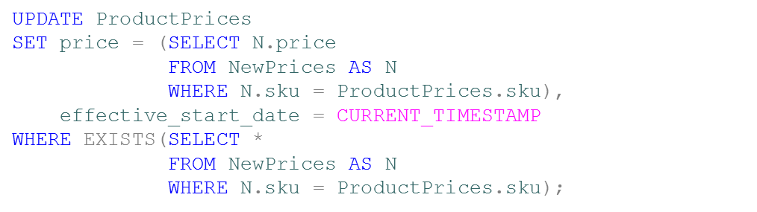
Cursors

Slide 29
Cursors (solutions)
Learn to write set based code
  Subqueries
  Joins
Exceptions – One time, or rare, tasks
Administrative tasks
  Sp_msForEachxxxx

Slide 30
SA Account Usage
SA is like root, Administrator
  Sysadmin privilege level account
This is an administrative account, not intended to be used by applications
Violates the principle of “Least Privilege”
No reason to use this in SQL 2008 and later

Slide 31
SA Account Usage (Solutions)
Use granular privileges
Learn SQL Server security model
  GRANT/REVOKE/DENY
  CONTROL, SELECT, INSERT, DELETE, EXECUTE, etc
EXECUTE AS works in many cases.

Slide 32
Shrinking Databases Regularly
Don’t shrink
Don’t shrink in maintenance plans
Don’t DBCC Shrinkdatabase
  Use DBCC Shrinkfile rarely

Slide 33
Shrinking Databases Regularly
Why not?
  Introduces Fragmentation
  Lowers performance
  Queries take longer

Slide 34
Demo
/*
Code copyright 2010 SQLskills and Paul Randal, www.sqlskills.com
Code republished for demonsrtation purposes only.
*/
USE MASTER;
GO
IF DATABASEPROPERTYEX ('DBMaint2008', 'Version') > 0
DROP DATABASE DBMaint2008;
CREATE DATABASE DBMaint2008;
GO
USE DBMaint2008;
GO
SET NOCOUNT ON;
GO
-- Create the 10MB filler table at the 'front' of the data file
CREATE TABLE FillerTable (c1 INT IDENTITY, c2 CHAR (8000) DEFAULT 'filler');
GO
-- Fill up the filler table
INSERT INTO FillerTable DEFAULT VALUES;
GO 1280
-- Create the production table, which will be 'after' the filler table in the data file
CREATE TABLE ProdTable (c1 INT IDENTITY, c2 CHAR (8000) DEFAULT 'production');
CREATE CLUSTERED INDEX prod_cl ON ProdTable (c1);
GO
INSERT INTO ProdTable DEFAULT VALUES;
GO 1280
-- check the fragmentation of the production table
SELECT [avg_fragmentation_in_percent] FROM sys.dm_db_index_physical_stats (
DB_ID ('DBMaint2008'), OBJECT_ID ('ProdTable'), 1, NULL, 'LIMITED');
GO
-- drop the filler table, creating 10MB of free space at the 'front' of the data file
DROP TABLE FillerTable;
GO
-- shrink the database
DBCC SHRINKDATABASE (DBMaint2008);
GO
-- check the index fragmentation again
SELECT [avg_fragmentation_in_percent] FROM sys.dm_db_index_physical_stats (
DB_ID ('DBMaint2008'), OBJECT_ID ('ProdTable'), 1, NULL, 'LIMITED');
GO

Slide 35
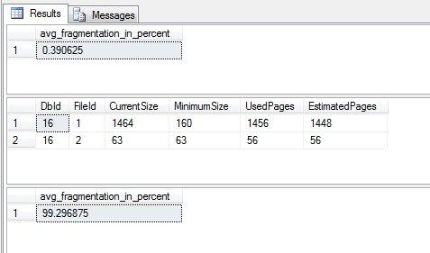

Slide 36
Shrinking Databases – Solutions
Manage Your Space
Include a pad for maintenance operations and data growth
If you have a massive data removal (delete, archive, etc.), then plan your shrink, and leave a pad for maintenance operations.

Slide 37
Shrinking Logs
Shrinking logs is not as bad.
Waste of resources if the log will just grow again.
What to do?
  Manage space
  Grow in chunks as needed
  Watch VLFs
  Shrink only as a rare operation if there has been a rare, unexpected operation that caused the log to grow.

Slide 38
Assigning Rights to Users
The default permission set is no access.
When Bill needs access, typically what happens?
Assign SELECT, INSERT, UPDATE, DELETE to Bill
What’s next?

Slide 39
Assigning Rights to Users
Bill quits and Tom takes his place.
How do you reassign rights to Tom?
  Manually
  Script
Neither of these is preferable.

Slide 40
Assigning Rights to Users - Solutions
Use Roles
Create a Database Role for each job that needs to be done
  GRANT permissions to the role
  Assign users to the role.
Allows you to backtrack permissions for multiple users easier.

Slide 41
Other Issues
SQL 89 v SQL 92 Syntax
Naming (Keywords)
Integer Division
Date Formats
Data Type Precedence
Declaring varchar (or nvarchar) without length
Division by zero handling
No Transaction Log Backups
more

Slide 42
Thanks
Hope you learned something
Pass the word (blog, colleagues, etc)
sjones@sqlservercentral.com
Thanks to Plamen Ratchev for some slides
  Blog http://pratchev.blogspot.com

Slide 43
References
Shrinking Databases
Why you should not shrink your data files
Shrinking databases
Leaning on Autogrow
Transaction Log VLFs - too many or too few?
GUID as a Clustered Key
Common SQL Server Mistakes – GUID as a Clustered PK
GUIDs as PRIMARY KEYs and/or the clustering key
How Using GUIDs in SQL Server Affect Index Performance

Slide 44
References
SELECT *
Common SQL Server Mistakes - SELECT *
SQL SERVER – SELECT * and Adding Column Issue in View – Limitation of the View 4
Chapter 14 – Improving SQL Server Performance (select only the rows and columns needed)
Function in WHERE Clause
The Cost of Function Use in a Where Clause
Avoid functions in the SQL Server WHERE clause for Performance Improvements

Slide 45
References
Is NULL
Understanding the Difference Between IS NULL and = NULL
NULL v NULL?
Cursors
Cursor Performance
Chapter 14 — Improving SQL Server Performance
Performance Tuning SQL Server Cursors

